Slide 1
Introduction to Software Engineering
CS-231
Instructor: Ms. Sadia Waheed Department of Computer Science University of Wah

Slide 2
What is a Software Process?
A framework that describes the activities performed at each stage of a software development project.
A set of activities whose goal is the development or evolution of software.
Generic activities in all software processes are:
Software Specification
Software Development
Software Validation
Software Evolution

Slide 3

Software Engineering Layers
Software engineering encompasses a process, methods for managing and engineering software, and tools.
Notes:
Software engineering tools provide automated or semi-automated support for the process and the methods.
Software engineering methods provide the technical how-to’s for building software.
The foundation for software engineering is the process layer. The software engineering process is the glue that holds the technology layers together and enables rational and timely development of computer software.
The bedrock that supports software engineering is a quality focus.

Slide 4
A quality focus
It defines the continuous process improvement principles of software.
It provides integrity that means providing security to the software so that data can be accessed by only an authorized person, no outsider can access the data.
It also focuses on maintainability and usability.

Slide 5
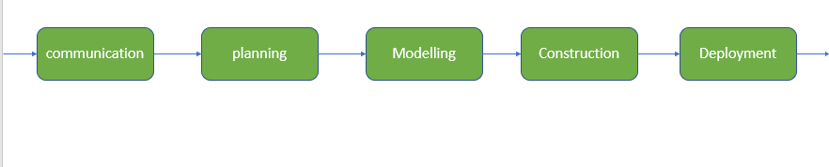
Process
It is the foundation or base layer of software engineering.
It is key that binds all the layers together which enables the development of software before the deadline or on time.
The software process covers all the activities, actions, and tasks required to be carried out for software development.

Slide 6
Process activities
Communication: Communication is necessary to know the actual demand of the client.
Planning: It basically means drawing a map for reduced the complication of development.
Modeling: In this process, a model is created according to the client for better understanding.
Construction: It includes the coding and testing of the problem.
Deployment:- It includes the delivery of software to the client for evaluation and feedback.

Slide 7
Method
During the process of software development the answers to all “how-to-do” questions are given by method.
It has the information of all the tasks which includes communication, requirement analysis, design modeling, program construction, testing, and support.
Tools

Slide 8
Software vs Hardware
Software: Intangible parts of computer
Software is a logical system element.
Software is developed or engineered.
Hardware: Tangible parts of computer
Hardware is a physical system element
Hardware is manufactured in the classical sense.

Slide 9
Similarities and Differences
Although some similarities exist between software development and hardware manufacturing, the two activities are fundamentally different.
In both activities, high quality is achieved through good design, but the manufacturing phase for hardware can introduce quality problems that are nonexistent for software.
Both activities are dependent on people, but the relationship between people applied and work accomplished is entirely different.
Both activities require the construction of a “product,” but the approaches are different.

Slide 10
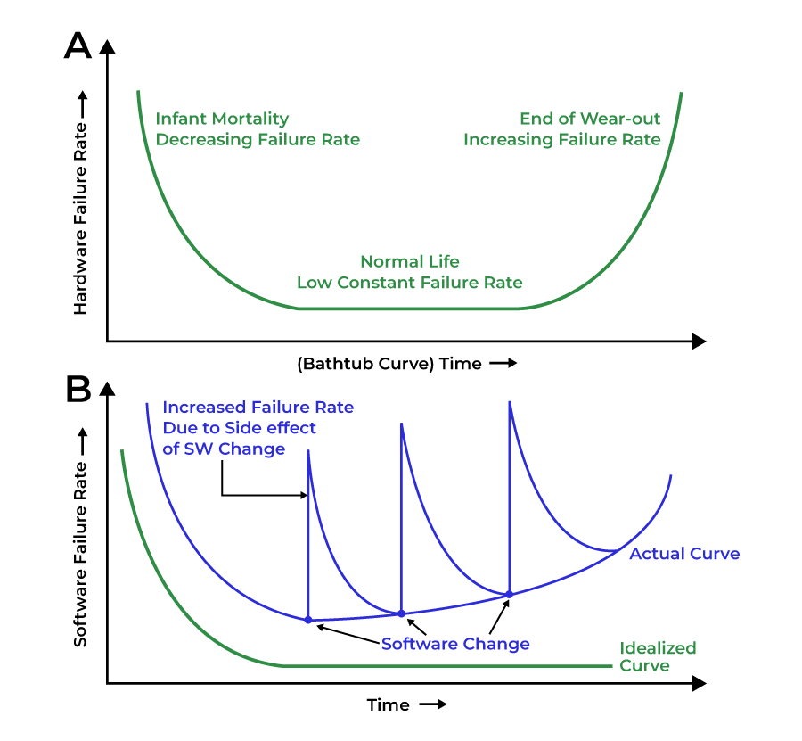
Failure Curve

Slide 11
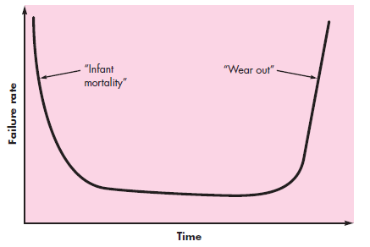
Failure Curve For Hardware
Hardware wears out with time.
Notes:
The graph shown indicates that hardware exhibits relatively high failure rates early in its life (these failures are often attributable to design or manufacturing defects); defects are corrected and the failure rate drops to a steady-state level (hopefully, quite low) for some period of time. As time passes, however, the failure rate rises again as hardware components suffer from the cumulative effects of dust, vibration, abuse, temperature extremes, and many other environmental maladies. The hardware begins to wear out.
A bathtub curve is a visual representation of the failure rate of a product or group of products over time. By plotting the occurrences of failure over time, a bathtub curve maps out three periods that an asset experiences within its lifetime:
Infant mortality period
Wear-out period
The infant mortality period, also known as the early failure period, begins when a product is used for the first time. It is an interval characterized by a decreasing failure rate that starts from a high failure occurrence, quickly decreasing to a lower failure rate, and plateauing. Failures that occur within this time are usually driven by manufacturing defects or installation issues. Other causes of failure events in this period could be design flaws or improper start-up procedures.
Assets naturally deteriorate over time. The number of failure occurrences that an asset experience expectedly increases after a certain usage period.
The wear-out region in the bathtub curve is characterized by this increasing trend of the failure rate. As failure rates increase quickly before the end of an asset life cycle, the bathtub curve slopes sharply upward. Eventually, this leads to the total failure of an asset.

Slide 12
The graph shown indicates that hardware exhibits relatively high failure rates early in its; defects are corrected and the failure rate drops to a steady-state level (hopefully, quite low) for some period of time. As time passes, however, the failure rate rises again as hardware components suffer from the cumulative effects of dust, vibration, abuse, temperature extremes, and many other environmental maladies. The hardware begins to wear out.
A bathtub curve is a visual representation of the failure rate of a product or group of products over time. By plotting the occurrences of failure over time, a bathtub curve maps out three periods that an asset experiences within its lifetime:
Infant mortality period
Wear-out period
The infant mortality period, also known as the early failure period, begins when a product is used for the first time. It is an interval characterized by a decreasing failure rate that starts from a high failure occurrence, quickly decreasing to a lower failure rate. Failures that occur within this time are usually driven by manufacturing defects or installation issues. Other causes of failure events in this period could be design flaws or improper start-up procedures.

Slide 13
Assets naturally deteriorate over time. The number of failure occurrences that an asset experience expectedly increases after a certain usage period.
The wear-out region in the bathtub curve is characterized by this increasing trend of the failure rate. As failure rates increase quickly before the end of an asset life cycle, the bathtub curve slopes sharply upward. Eventually, this leads to the total failure of an asset.

Slide 14
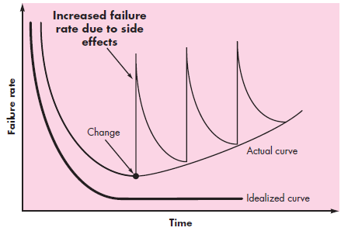
Failure Rate Curve For Software
Software does not “wear out” but it does deteriorate.
The relationship is shown through “idealized curve” and “actual curve”.
Notes:
Undiscovered defects will cause high failure rates early in the life of a program. However, these are corrected and the curve flattens.
During its life, software will undergo change. As changes are made, it is likely that errors will be introduced, causing the failure rate curve to spike as shown in the “actual curve”.
Before the curve can return to the original steady-state failure rate, another change is requested, causing the curve to spike again. Slowly, the minimum failure rate level begins to rise—the software is deteriorating due to change.

Slide 15
Undiscovered defects will cause high failure rates early in the life of a program. However, these are corrected and the curve flattens.
During its life, software will undergo change. As changes are made, it is likely that errors will be introduced, causing the failure rate curve to spike as shown in the “actual curve”.
Before the curve can return to the original steady-state failure rate, another change is requested, causing the curve to spike again. Slowly, the minimum failure rate level begins to rise—the software is deteriorating due to change.

Slide 16
“Wear out” Aspect
When a hardware component wears out, it is replaced by a spare part. There are no software spare parts.
Every software failure indicates an error in design or in the process through which design was translated into machine executable code.
Therefore, the software maintenance tasks that accommodate requests for change involve considerably more complexity than hardware maintenance.

Slide 17
Software Domains
Based on Application
Based on Copyright

Slide 18
Based on Application
System Software:
System Software is necessary to manage computer resources and support the execution of application programs.
Operating systems, compilers, editors and drivers, etc
Application Software:
Application software is designed to fulfill the user’s requirement by interacting with the user directly.
It could be classified into two major categories:- generic or customized.

Slide 19
Based on Application
Networking and Web Applications Software:
Networking Software provides the required support necessary for computers to interact with each other and with data storage facilities.
Networking software is also used when software is running on a network of computers (such as the World Wide Web).
Security and encryption software, and software to develop web-based applications like HTML, PHP, XML

Slide 20
Based on Application
Embedded Software:
This type of software is embedded into the hardware normally in the Read-Only Memory (ROM) as a part of a large system and is used to support certain functionality under the control conditions.
Control applications like washing machines, satellites, microwaves

Slide 21
Based on Application
Business Software:
This category of software is used to support business applications and is the most widely used category of software. Examples are software for inventory management, accounts, banking, hospitals, schools, stock markets, etc.
Artificial Intelligence Software:
Software like expert systems, decision support systems, pattern recognition software, artificial neural networks,

Slide 22
Based on Application
Scientific Software:
Such software is written for specific applications using principles, techniques, and formulae particular to that field.
Examples are software like MATLAB, AUTOCAD, PSPICE, ORCAD, etc.

Slide 23
Based on Copyright
Commercial Software:
It represents the majority of software that we purchase from software companies, commercial computer stores, etc.
In this case, when a user buys software, they acquire a license key to use it. Users are not allowed to make copies of the software. The company owns the copyright of the program.
Shareware Software:
The purchasers are allowed to make and distribute copies with the condition that after testing the software, if the purchaser adopts it for use, then they must pay for it.
In both of the above types of software, changes to the software are not allowed.

Slide 24
Based on Copyright
Freeware Software:
Copies of the software can be made both for archival and distribution purposes, but here, distribution cannot be for making a profit.
Modifications to the software are allowed.
Public Domain Software:
Software copies can be made both for archival and distribution purposes with no restrictions on distribution.
Modifications to the software allowed.

Slide 25
Legacy Software
Legacy software systems were developed decades ago and have been continually modified to meet changes in business requirements and computing platforms.
The proliferation of such systems is causing headaches for large organizations who find them costly to maintain and risky to evolve.
Notes:
Poliferation .... Modification/ Build up

Slide 26
Problems In Legacy Systems
Most legacy systems are of poor quality (inextensible designs, convoluted code, poor or nonexistent documentation, poor testing, poor change management).
What to do?
Do nothing, at least until the legacy system must undergo some significant change.
If the legacy software meets the needs of its users and runs reliably, it isn’t broken and does not need to be fixed.

Slide 27
Evolution of Legacy systems
However, as time passes, legacy systems often evolve for one or more of the following reasons:
The software must be adapted to meet the needs of new computing environments or technology.
The software must be enhanced to implement new business requirements.
The software must be extended to make it interoperable with other more modern systems or databases.
The software must be re-architected to make it viable within a network environment.
When these modes of evolution occur, a legacy system must be reengineered, so that it remains viable into the future.
Notes:
Reengineering (Chapter 29)

Slide 28
General issues that affect software
Security and trust
It is essential that we can trust the software. This is especially true for remote software system access through a web page or web services infrastructure. We have to make sure that miscellaneous data or files or users cannot attack our software and that information security is maintained.
For example- with the increasing reliance on online banking security is major and crucial to protecting insensitive financial information. Software must be fortified against pushing attempts, malware and other cyber threats.
Notes:
interweave

Slide 29
General issues that affect software
Business and social change
This changes quickly as emerging economies develop and new technologies become available. They need to be able to change and evolve their existing software and so rapidly develop new software by reducing the delivery time. Many traditional software engineering techniques are time-consuming and delivery of new systems often takes longer than planned.
For example- an e-commerce platform needs to add up to changing customer behaviour and emerging technologies to remain competitive agile Development Methodologies enable quick adjustment and feature rollouts.

Slide 30
General issues that affect software
Heterogeneity
Developers often have to integrate new software with older legacy systems, written in different programming languages like JAVA or Python. The challenge here is to develop a technique for building dependable software that is flexible enough to cope with the heterogeneity.
Example- Imagine a cloud-based application needed to interact with both traditional desktop computers and modern devices. Bridging the gap between this diversion platform requires a flexible and robust software architecture

Slide 31
Software Engineering diversity
There are many different types of software system and there is no universal set of software techniques that is applicable to all of these.
The software engineering methods and tools used depend on the type of application being developed, the requirements of the customer and the background of the development team.

Slide 32
Application Types
Stand-alone applications
These are application systems that run on a local computer, such as a PC. They include all necessary functionality and do not need to be connected to a network.
Interactive transaction-based applications
Applications that execute on a remote computer and are accessed by users from their own PCs or terminals. These include web applications such as e-commerce applications.
Embedded control systems
These are software control systems that control and manage hardware devices. Numerically, there are probably more embedded systems than any other type of system.

Slide 33
Application Types
Batch processing systems
These are business systems that are designed to process data in large batches. They process large numbers of individual inputs to create corresponding outputs.
Entertainment systems
These are systems that are primarily for personal use and which are intended to entertain the user.
Systems for Modelling and Simulation
These are systems that are developed by scientists and engineers to model physical processes or situations, which include many, separate, interacting objects.

Slide 34
Application Types
Data collection systems
These are systems that collect data from their environment using a set of sensors and send that data to other systems for processing.
Systems of Systems
These are systems that are composed of a number of other software systems.

Slide 35
Goal of modern Software Engineering
The goal of modern software engineering is to “devise methodologies that are founded on the notion of evolution”; that is, the notion that software systems continually change, new software systems are built from the old ones, and . . . all must interoperate and cooperate with each other” [Day99].

